Slide 1
Turning your Data/AI algorithms
into Full Web Applications
in no time with Taipy
February, 2024
Presented by Avaiga

Slide 2
The Problem
Low success rate of Python Data/AI projects while companies spend vast amounts of money on them.
(Gartner 2019)

Slide 3
The Causes
Lack of a common software platform,
Gap between IT teams and End-Users …
Difficulty to recruit Talents,
Current siloed approach is not working,
(IDC 2020)

Slide 4






From pilot to project,
Over 85% failure!
Data
Data Engineer
Data Scientist
ML
Ops
IT Developer+ DevOps
End user
Notes:
Astrid: Is that what you meant?

Slide 5
Almost 90% of data applications take too long, are too costly to develop and deploy.
Source: IDC 2020 FutureScape: Worldwide Data and Analytics 2021 Predictions
3

Slide 6
The Solution

Slide 7
What is Taipy?

Slide 8

Taipy covers both
Frontend + Backend
100% Python webapp development
Open-Source & Enterprise license
Easy to learn

Slide 9
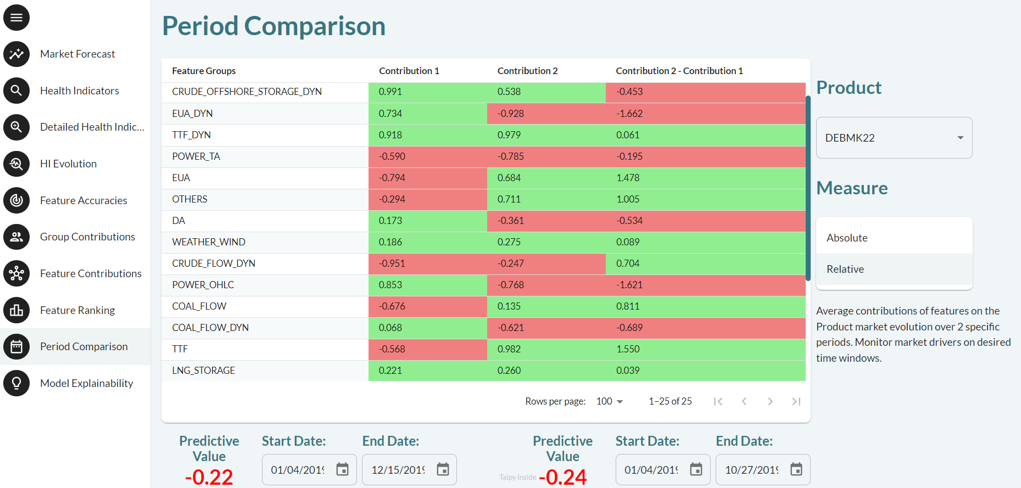
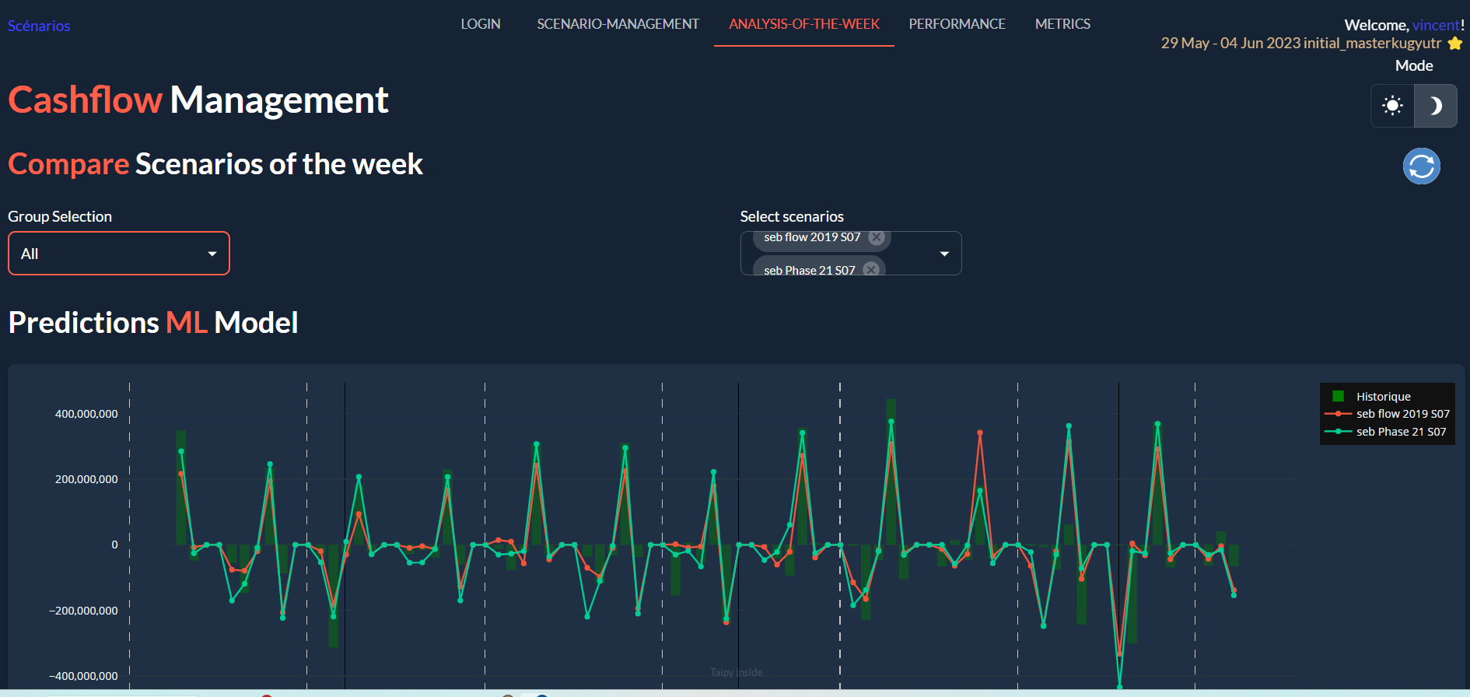
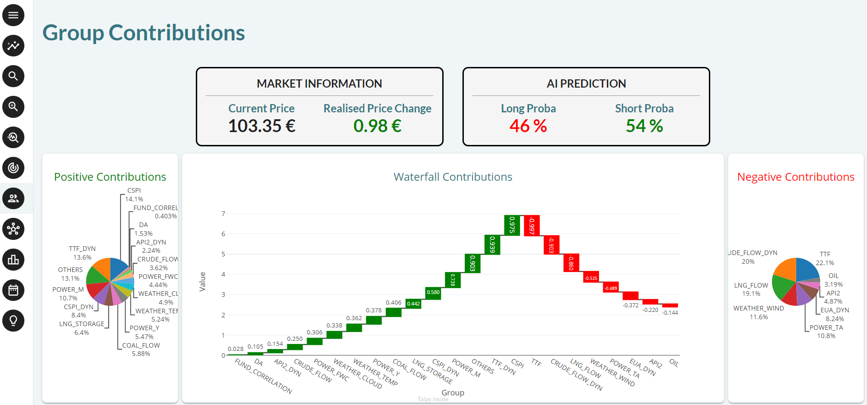
Taipy
Covers:
DashBoards, Data Apps,
AI (ML, DL, RL),
Simulation,
Operations Research,
Ad-hoc Algos,
and more.

Slide 10









Taipy frontend
Completeness of solution
Python Graphical Packages
Ease of coding

Slide 11


Taipy frontend
 | Taipy | Other GUI Packages
Efficient Event loop
Sync / Async Calls
Easy Customization
Notebook Compat.
Markdown
Large Data Support
Multi-Users
Performance
Python Graphical Packages

Slide 12
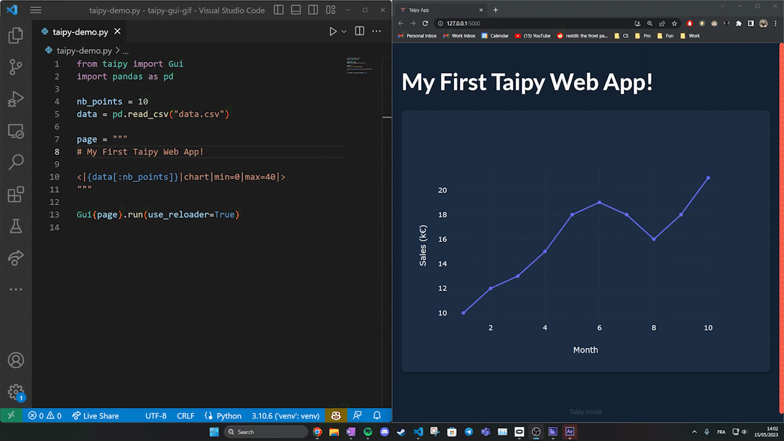
Taipy frontend
Python GUI Builder

Slide 13
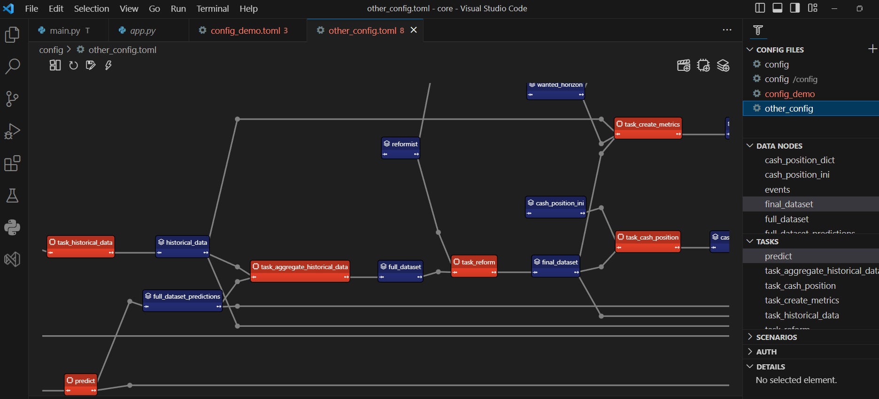
Taipy backend
Powerful Pipelines with Scenario Management

Slide 14
Taipy backend
 | Taipy | Other Pipeline Management Packages
Pipeline Execution |  | do_
Scenario Mgt
Caching
Data Scoping
Versioning
Cycles
Time to master | Short | Long
Execution Pipelines with
Scenario Management

Slide 15
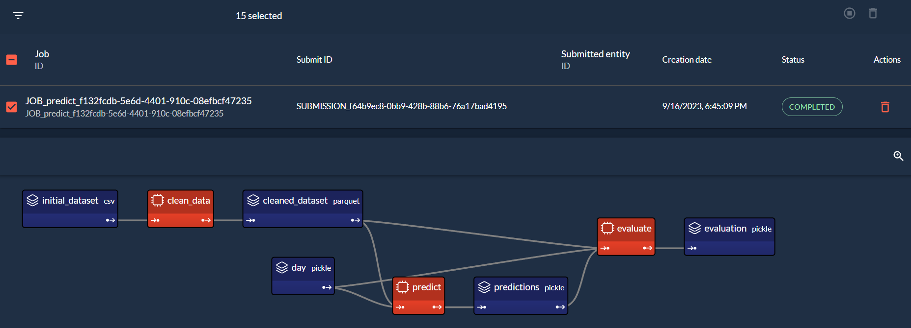
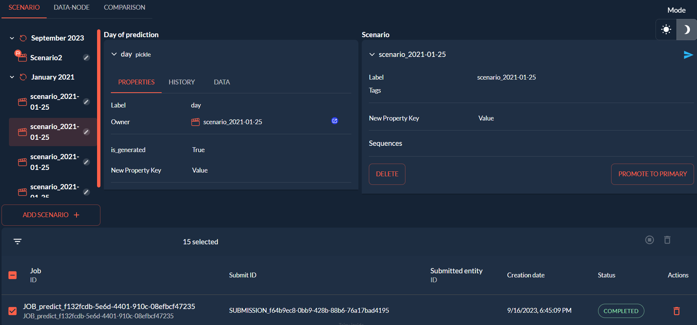
Frontend and backend integration
Pipeline Execution
Monitoring
Graphical Explorers for your Data Nodes
Graphical Explorers for your executions (Scenarios)
Registering and Visualising your past Executions (ie Scenarios)

Slide 16
The Results

Slide 17
Successful projects at reduced costs
4 x
10 x
Reduce development/ deployment time.
Savings of resources and costs
Benefits
Much faster industrialization of projects.
Save development & deployment time
Reduce maintenance costs.
Facilitate collaboration.
Better performance
Much higher ROIs
Benefits
90% of development work performed by Python developers.
Little to zero need for resources from other departments.
Much lighter in terms of project management.

Slide 18
Reduce Overall Cost by a
factor 10 !
Project Example: Intermarché’s Cash Flow Management | Budget | Number of IT personnel | Project Duration
Initial Option | 600K | 4 | 8 Months
Intermarché’s IT Div using Taipy | 60K | 1.5 | 2 Months

Slide 19



“ Taipy has become a core product for our AI strategy. Taipy allows to develop, deploy and maintain our AI applications with ease. It is an integral part of our corporate IT platform.”
Arnaud de Ligniville, CFO Intermarché
Taipy brings all the functionalities needed for an AI driven supply chain: Scenario Management, great UX, Predictive and Prescriptive AI, etc. And all at a fraction of the costs of alternative solutions.
Dang Huynh Uc My, Chairman TTC Sugar
Taipy enables us to implement the best practices to succeed with the industrialization of AI apps. It saves us several years of hard learning, many resources and has decreased the deployment of our apps drastically.
Jesselynn M., Responsible for McDonald’s HR applications

Slide 20









Slide 21
Taipy Enterprise
Overview

Slide 22
Taipy Enterprise
Product
Taipy Community
Taipy Enterprise
Taipy Open-Source
Product Support
Authentication
Authorization / Roles
Performance
Scheduler
Distributed Computing
Taipy Designer

Slide 23
Taipy Sales Engagement Process
Discover Define Prove
Discovery Session
TaiPython
Session
Pilot Engagement
Use Case(s) specification
Selection and Specification
Joint Pilot implementation
Business & Technical alignment
Joint POC working session
Project specification and costing
Problem statement(s)
Business case definition
Executive approval for project
Business value/outcome
Pilot definition
Procurement Process
Time-line
Pricing for Pilot

Slide 24
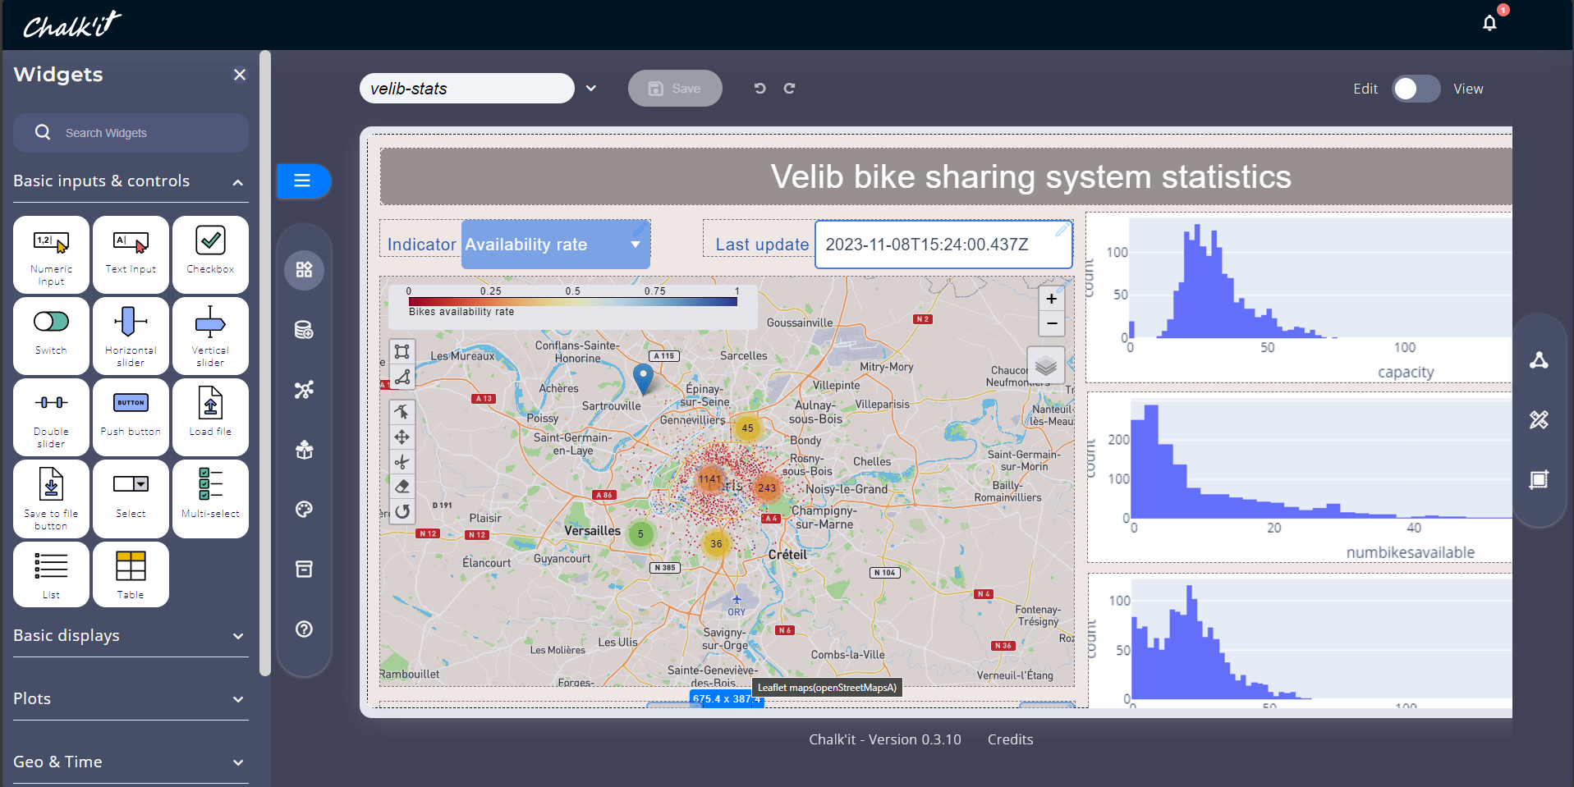
Taipy Designer - Example

Slide 25
Taipy has a ‘natural’ integration
with
Data Analytics Platforms

Slide 26


Examples
Databricks,
Dataiku
AWS SageMaker
Google Colab
IBM WatsonX,
etc.
Taipy Application connects Databricks Data Sources
Taipy embedded in Dataiku
Taipy Application calls Databricks Jobs
Taipy application calls Dataiku pipelines
Run Taipy within Databricks Notebooks

Slide 28
Additional Slides

Slide 29
Taipy’s own Cloud,
Taipy Cloud

Slide 30
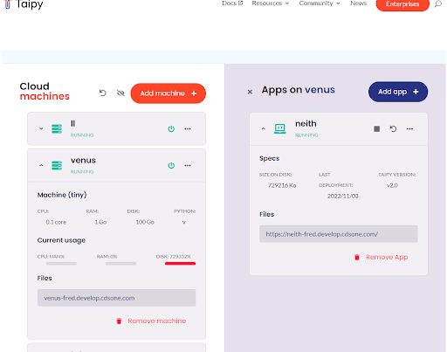
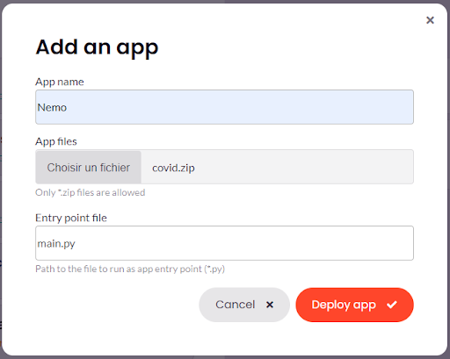
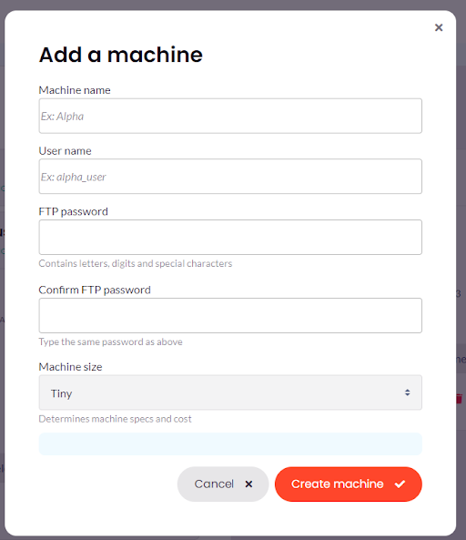
Taipy Cloud
Deploy your Taipy Application with Point & Click
Anyone can deploy on Taipy Cloud!

Slide 31
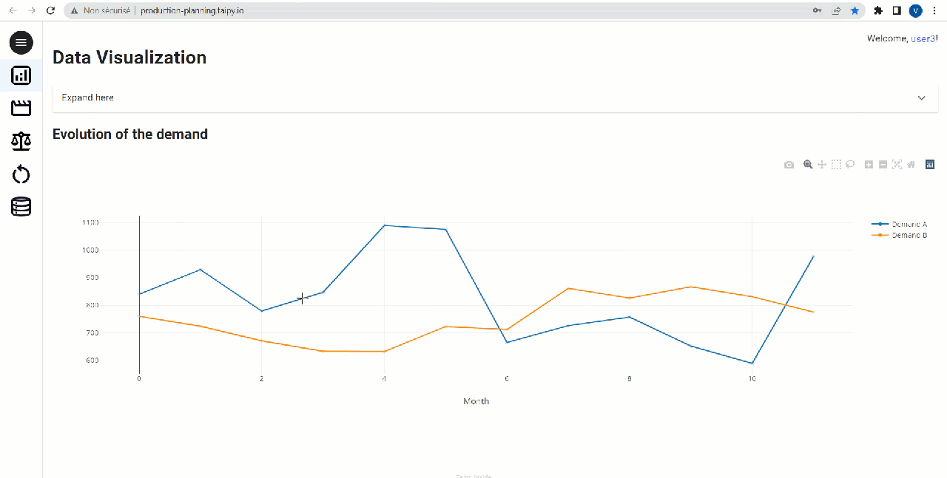
Taipy Demo

Slide 32
Only 20% of analytic insights delivered business insights through 2022.
While companies spent 271B$ on Data Analytics
Sources: Gartner 2019, Our Top Data and Analytics Predicts for 2019
Fortune Business Insights 2022, Big Data Analytics Market Size
3

Slide 33
Taipy is launching its own LLM,
TalkToTaipy

Slide 34
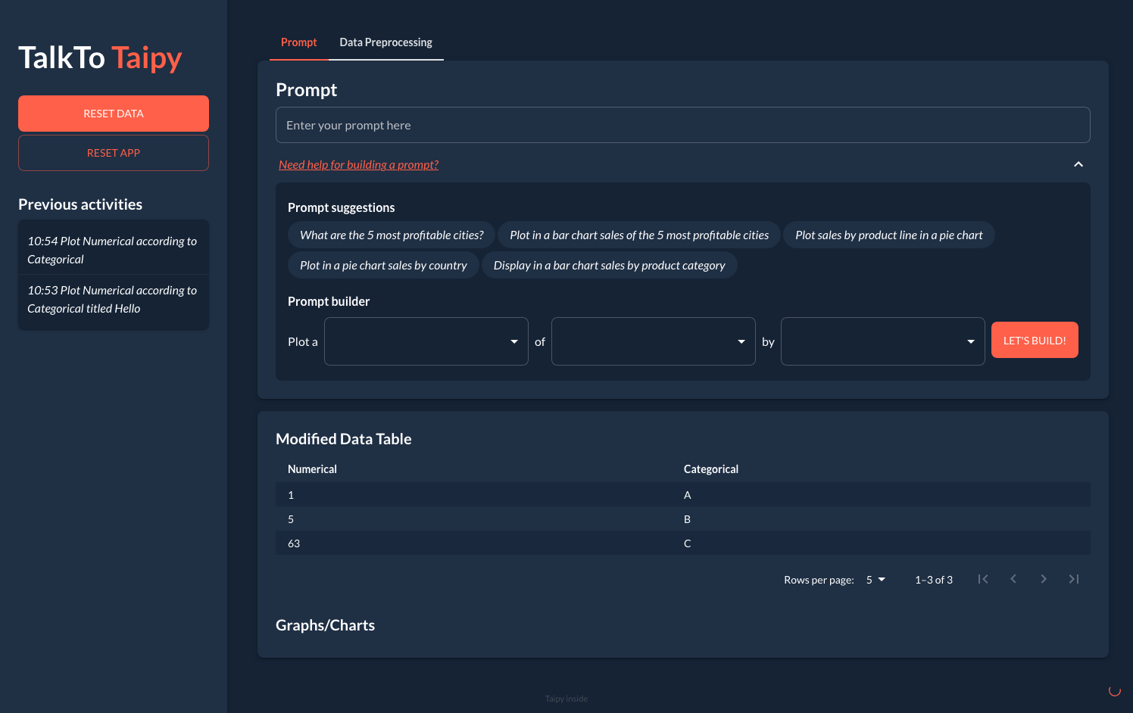
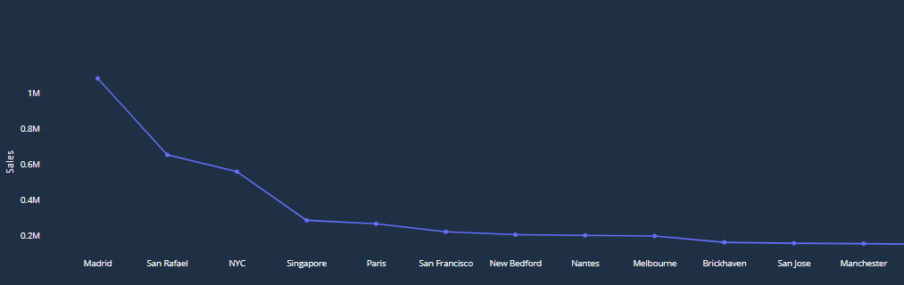
TalkToTaipy
Taipy Application
Generates Taipy code
Load your own excel/csv table(s)
Ask any question
Generates Taipy graphical charts

